Slide 1

SDM5013:
Deep Learning and Reinforcement Learning
Zhiyun Lin

Slide 2
Lecture: Introduction
Administration details
Deep Learning and Reinforcement Learning

Slide 3
The Team
Instructor:
Zhiyun Lin (林志赟)
Email:
linzy@sustech.edu.cn
Office:
Room 602, Buidling 10, Chuangyuan
TA:
吴金泽 jinze.wu@polito.it
朱骏玮 12431380@mail.sustech.edu.cn
陈梓杰 12333205@mail.sustech.edu.cn
李文杰 12332628@mail.sustech.edu.cn

Slide 4

Course Information
Lecture time and place:
Monday 19:00PM-20:50PM in the 3rd Lecture hall 208 (weekly)
Instruction language:
Chinese and English
Lecture Website:
https://bb.sustech.edu.cn/
Class Group WeChat

Slide 5
Pre-requisites
Liberal wrt waiving pre-requisites
But it is up to you to determine if you have the appropriate background
Do I have the appropriate background?
Linear algebra: vector/matrix manipulations, properties
Calculus: derivatives and partial derivatives
Probability: common distributions; Bayes Rule
Statistics: mean/median/mode; maximum likelihood
Programming language: Python

Slide 6
Textbook(s)
Textbook:
R. S. Sutton and A. C. Barto, Reinforcement Learning: An Introduction (second edition), The MIT Press, 2018
C. M. Bishop, Pattern Recognition and Machine Learning, Springer, 2006
Other recommending book:
A. Downey, Think Python (version 2.0), Green Tea Press, 2012
E-books are available in SUSTech Blackboard

Slide 7
Provisional Calendar (32 credit hours): Part I
Lecture 01. Introduction to deep learning and reinforcement learning
Lecture 02. PyTorch basics
Lecture 03. Linear regression
Lecture 04. Linear classification
Lecture 05. Fully connected feedforward neural networks
Lecture 06. Convolutional neural networks (CNNs)
Lecture 07. Recurrent neural networks (RNNs)
Lecture 08. Attention and transformer neural networks

Slide 8
Provisional Calendar (32 credit hours): Part II
Lecture 09. Markov decision processes (MDP)
Lecture 10. Planning by dynamic programming
Lecture 11. Model-free prediction
Lecture 12. Model-free control
Lecture 13. Value function approximation
Lecture 14. Policy gradient
Lecture 15. Integrating learning and planning
Lecture 16. Deep reinforcement learning

Slide 9
Assessment
Class performance 10%:
Class attendance
In-class performance
Homework assignments
Projects 60% (mid-term project 30% + final project 30%) :
Two projects: coding + paper-like project report
Final exam 30%:
Paper and pencil with one A4 note sheet
All topics covered in the course

Slide 10
Learning Objectives
Upon completion of this course, you will ...
familiarize with broad classes of deep learning and reinforcement learning algorithms as well as their related fundamental theory
apply and adapt learned machine learning techniques to solve engineering problems and to your own research/thesis domain

Slide 11
Ways of Study
In class
Concentrate on the lecture
Understand at least 70%, otherwise you may stop your lecture instructor to continue
Raise your questions to help your understanding
After class
Do reading!
Do coding!
Practice, Practice, and Practice, ......

Slide 12
Lecture: Introduction
Administration details
Deep Learning and Reinforcement Learning

Slide 13


What is Artificial Intelligence?
Sora

Slide 14
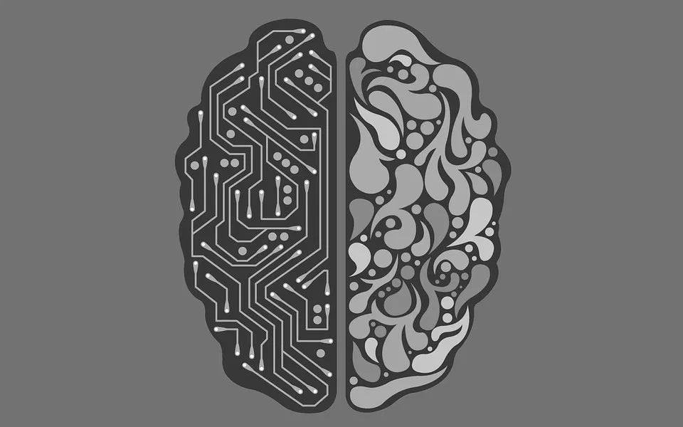
What is Artificial Intelligence?
Artificial intelligence (AI) is intelligence demonstrated by machines, as opposed to the natural intelligence displayed by animals including humans.
AI research has been defined as the field of study of intelligent agents, which refers to any system that perceives its environment and takes actions that maximize its chance of achieving its goals.

Slide 15
Key Takeaways of AI
Artificial intelligence (AI) refers to the simulation or approximation of human intelligence in machines.
The goals of artificial intelligence include computer-enhanced learning, reasoning, and perception.
AI is being used today across different industries from finance to healthcare.
Weak AI tends to be simple and single-task oriented, while strong AI carries on tasks that are more complex and human-like.
Some critics fear that the extensive use of advanced AI can have a negative effect on society.

Slide 16
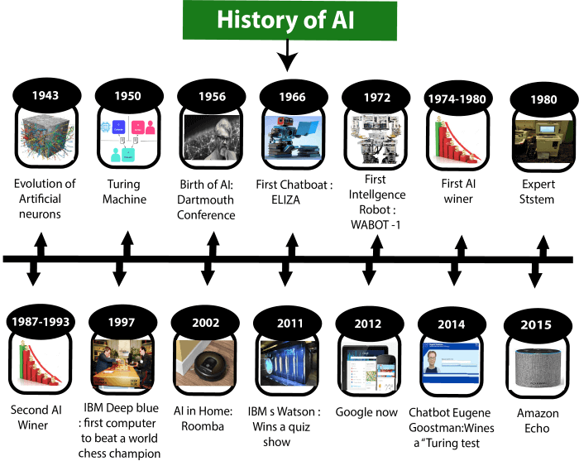
History of AI
Artificial Intelligence is not a new word and not a new technology for researchers. This technology is much older than you would imagine.

Slide 17
History of AI
Maturation of Artificial Intelligence (1943-1952)
Year 1943: The first work which is now recognized as AI was done by Warren McCulloch and Walter pits in 1943. They proposed a model of artificial neurons.
Year 1949: Donald Hebb demonstrated an updating rule for modifying the connection strength between neurons. His rule is now called Hebbian learning.
Year 1950: The Alan Turing who was an English mathematician and pioneered Machine learning in 1950. Alan Turing publishes "Computing Machinery and Intelligence" in which he proposed a test. The test can check the machine's ability to exhibit intelligent behavior equivalent to human intelligence, called a Turing test.

Slide 18
History of AI
The birth of Artificial Intelligence (1952-1956)
Year 1955: An Allen Newell and Herbert A. Simon created the "first artificial intelligence program" Which was named as "Logic Theorist". This program had proved 38 of 52 Mathematics theorems, and find new and more elegant proofs for some theorems.
Year 1956: The word "Artificial Intelligence" first adopted by American Computer scientist John McCarthy at the Dartmouth Conference. For the first time, AI coined as an academic field.
The golden years-Early enthusiasm (1956-1974)
Year 1966: The researchers emphasized developing algorithms which can solve mathematical problems. Joseph Weizenbaum created the first chatbot in 1966, which was named as ELIZA.
Year 1972: The first intelligent humanoid robot was built in Japan which was named as WABOT-1.

Slide 19
History of AI
The first AI winter (1974-1980)
The duration between years 1974 to 1980 was the first AI winter duration. AI winter refers to the time period where computer scientist dealt with a severe shortage of funding from government for AI researches.
During AI winters, an interest of publicity on artificial intelligence was decreased.
A boom of AI (1980-1987)
Year 1980: After AI winter duration, AI came back with "Expert System". Expert systems were programmed that emulate the decision-making ability of a human expert.
In the Year 1980, the first national conference of the American Association of Artificial Intelligence was held at Stanford University.

Slide 20
History of AI
The second AI winter (1987-1993)
The duration between the years 1987 to 1993 was the second AI Winter duration.
Again Investors and government stopped in funding for AI research as due to high cost but not efficient result. The expert system such as XCON was very cost effective.
The emergence of intelligent agents (1993-2011)
Year 1997: In the year 1997, IBM Deep Blue beats world chess champion, Gary Kasparov, and became the first computer to beat a world chess champion.
Year 2002: for the first time, AI entered the home in the form of Roomba, a vacuum cleaner.
Year 2006: AI came in the Business world till the year 2006. Companies like Facebook, Twitter, and Netflix also started using AI.

Slide 21
History of AI
Deep learning, big data and artificial general intelligence (2011-present)
2010: ImageNet launched the ImageNet Large Scale Visual Recognition Challenge (ILSVRC), their annual AI object recognition competition.
2011: Watson, a natural language question answering computer created by IBM, defeated two former Jeopardy! champions, Ken Jennings and Brad Rutter, in a televised game.
2014: Chatbot "Eugene Goostman" won a competition in the infamous "Turing test."
2015-2017: Google DeepMind’s AlphaGo, a computer program that plays the board game Go, defeated various (human) champions.
2021: AlphaFold: DeepMind’s protein-folding AI is transformational as understanding proteins and their complex 3D shapes is key to understanding life, and especially for developing drugs

Slide 22
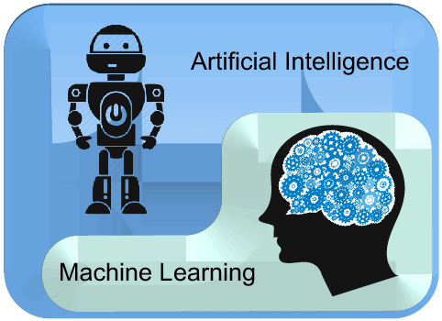
Machine Learning ≠ Artificial Intelligence
AI is a bigger concept to create intelligent machines that can simulate human thinking capability and behavior
Machine learning is an application or subset of AI that allows machines to learn from data without being programmed explicitly

Slide 23
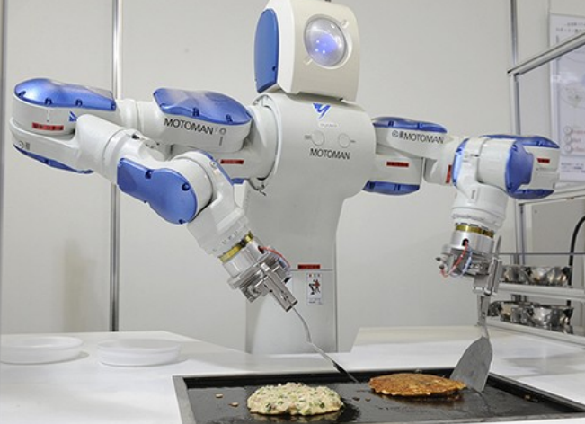
What is Machine Learning?
How can we solve a specific problem?
As computer scientists, we write a program that encodes a set of rules that are useful to solve the problem
Figure : Make a robot cook

Slide 24
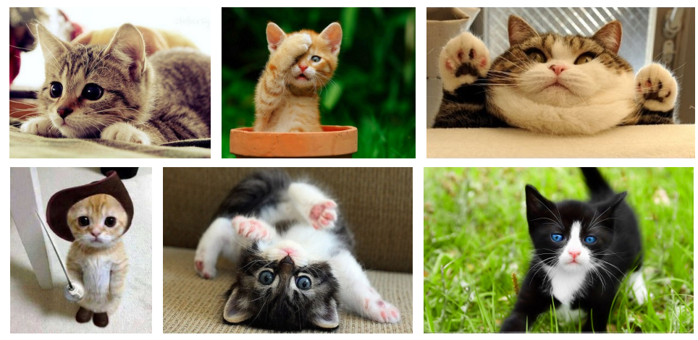
What is Machine Learning?
How can we solve a specific problem?
As computer scientists, we write a program that encodes a set of rules that are useful to solve the problem
But In many cases it is very difficult to specify those rules, e.g., given a picture determine whether there is a cat in the image

Slide 25
What is Machine Learning?
Learning systems are not directly programmed to solve a problem, instead, they develop own program (rules) based on:
Examples of how they should behave
From trial-and-error experience trying to solve the problem
Different than standard CS:
Want to implement unknown function, only have access e.g., to sample input-output pairs (training examples)
Learning simply means incorporating information from the training examples into the system

Slide 26
Tasks that requires machine learning: Recognizing a cat!
Machine learn to classify a cat picture
Offer a large number of cat pictures with labels and train a model
Use the trained model to predict where there is a cat or not for any given picture

Slide 27
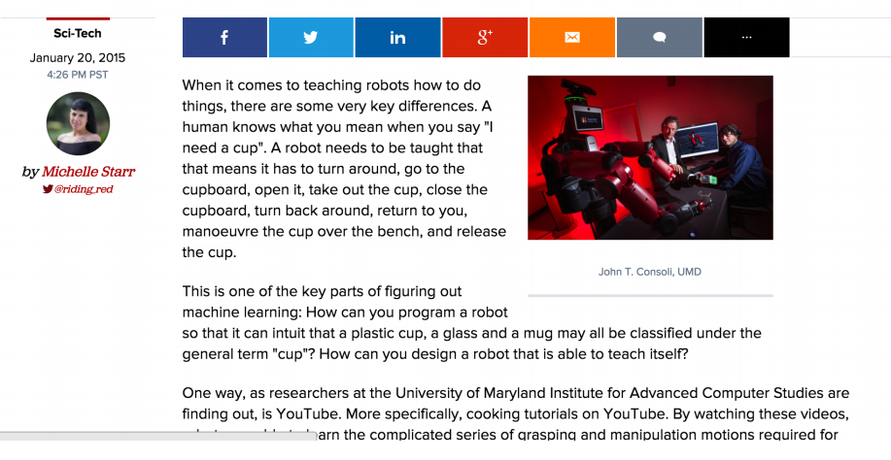
Tasks that benefits from machine learning: cooking!
Robots learn to cook by watching YouTube
When it comes to learning how to cook, it turns out that robots may not be so different from humans after all... or are they?

Slide 28
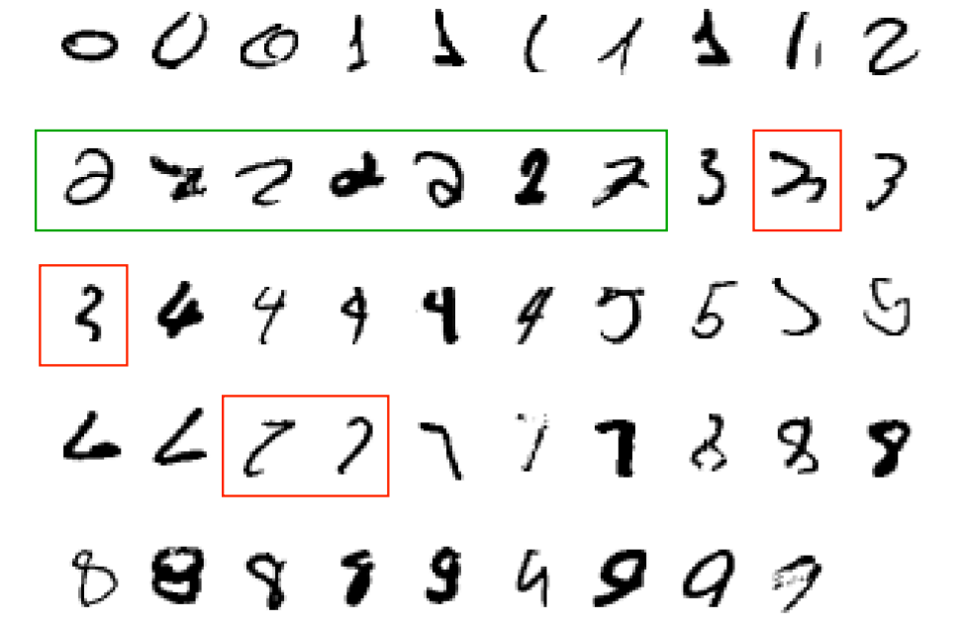
Why use learning?
It is very hard to write programs that solve problems like recognizing a handwritten digit
What distinguishes a 2 from a 7?

Slide 29
Why use learning?
It is very hard to write programs that solve problems like recognizing a handwritten digit
What distinguishes a 2 from a 7?
How does our brain do it?
Instead of writing a program by hand, we collect examples that specify the correct output for a given input
A machine learning algorithm then takes these examples and produces a program that does the job
The program produced by the learning algorithm may look very different from a typical hand-written program. It may contain millions of numbers.
If we do it right, the program works for new cases as well as the ones we trained it on.

Slide 30
Learning algorithms are useful in many tasks
1. Classification: Determine which discrete category the example is

Slide 31
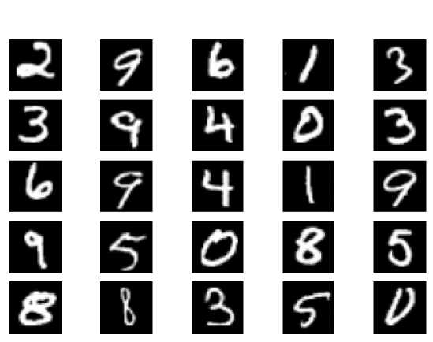
Examples of Classification
What digit is this?

Slide 32
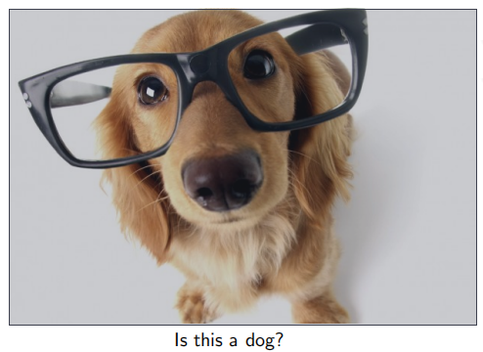
Examples of Classification

Slide 33
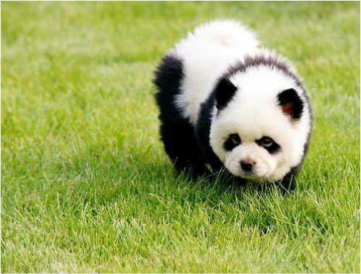
Examples of Classification
What about this one?

Slide 34

Examples of Classification
Am I going to pass the exam?

Slide 35
Learning algorithms are useful in many tasks
1. Classification: Determine which discrete category the example is
2. Recognizing patterns: Speech recognition, facial identity, etc

Slide 36
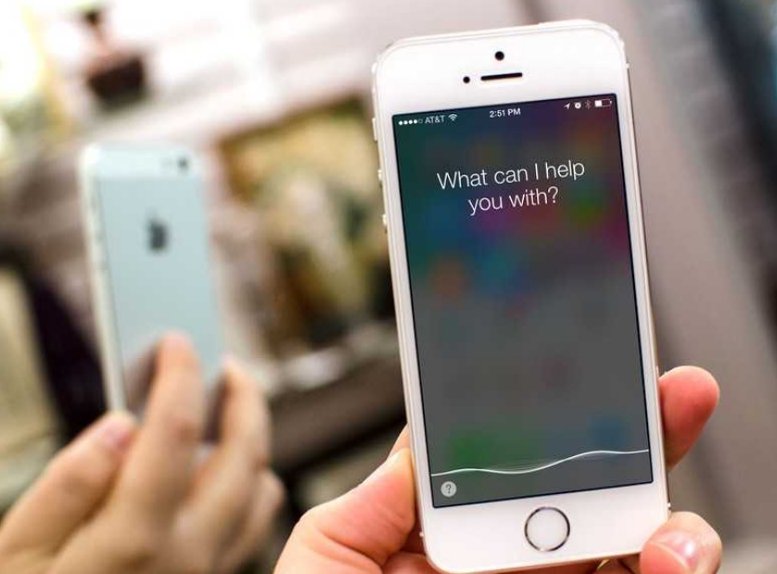
Examples of Recognizing Patterns
Siri supports a wide range of user commands, including performing phone actions, checking basic information, scheduling events and reminders. Its speech recognition engine uses advanced machine learning technologies to function.

Slide 37
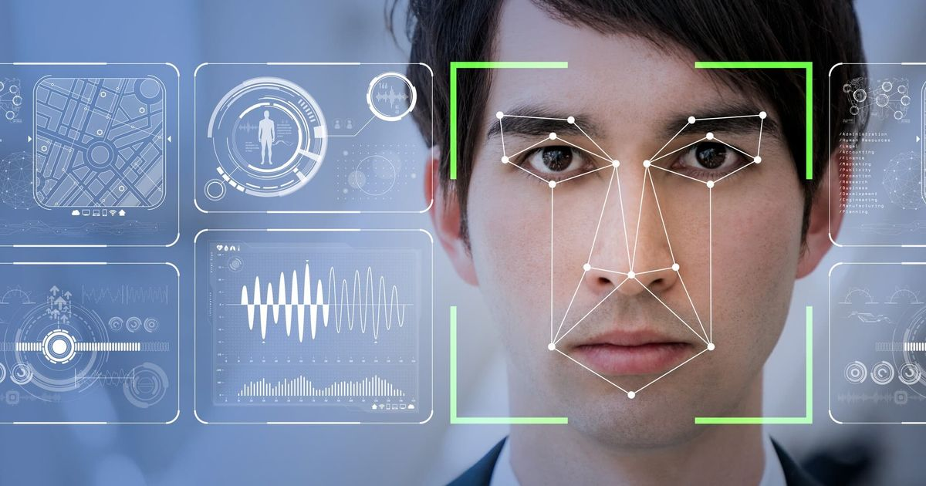
Examples of Recognizing Patterns
Facial recognition system: Matching a human face from a digital image or a video frame against a database of faces, typically employed to authenticate users through ID verification services, works by pinpointing and measuring facial features from a given image.

Slide 38
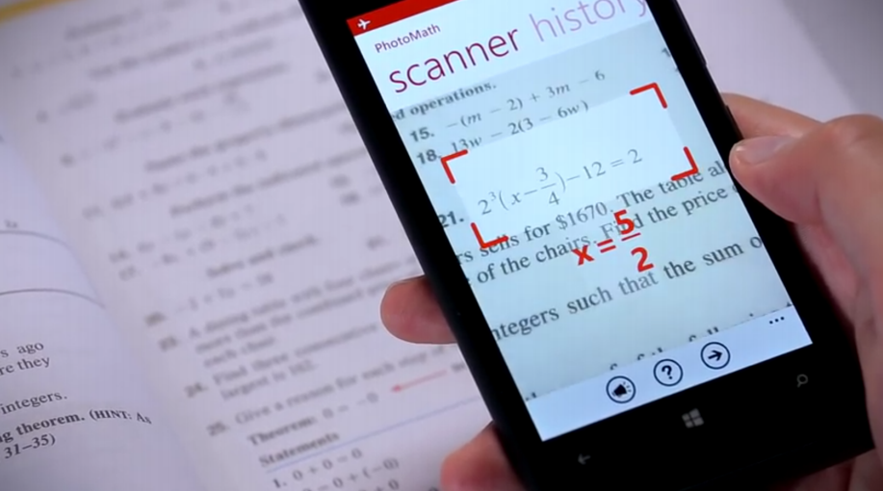
Examples of Recognizing Patterns
Figure : Photomath: https://photomath.net/
Photomath is a mobile computer algebra system with an augmented optical character recognition system designed for use with a smartphone's camera to scan and recognize mathematical equations.

Slide 39
Learning algorithms are useful in other tasks
1. Classification: Determine which discrete category the example is
2. Recognizing patterns: Speech Recognition, facial identity, etc
3. Recommender systems: Noisy data, commercial pay-off (e.g., TikTok, Taobao, Amazon, Netflix).

Slide 40
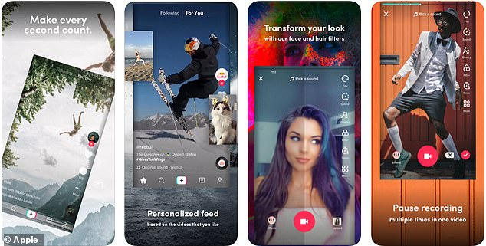
Examples of Recommendation Systems
How TikTok recommends videos #ForYou

Slide 41

Examples of Recommendation Systems
Aims at providing users with attention-grabbing items based on their preferences in Taobao

Slide 42
Learning algorithms are useful in other tasks
1. Classification: Determine which discrete category the example is
2. Recognizing patterns: Speech Recognition, facial identity, etc
3. Recommender systems: Noisy data, commercial pay-off (e.g., TikTok, Taobao).
4. Information retrieval: Find documents or images with similar content

Slide 43
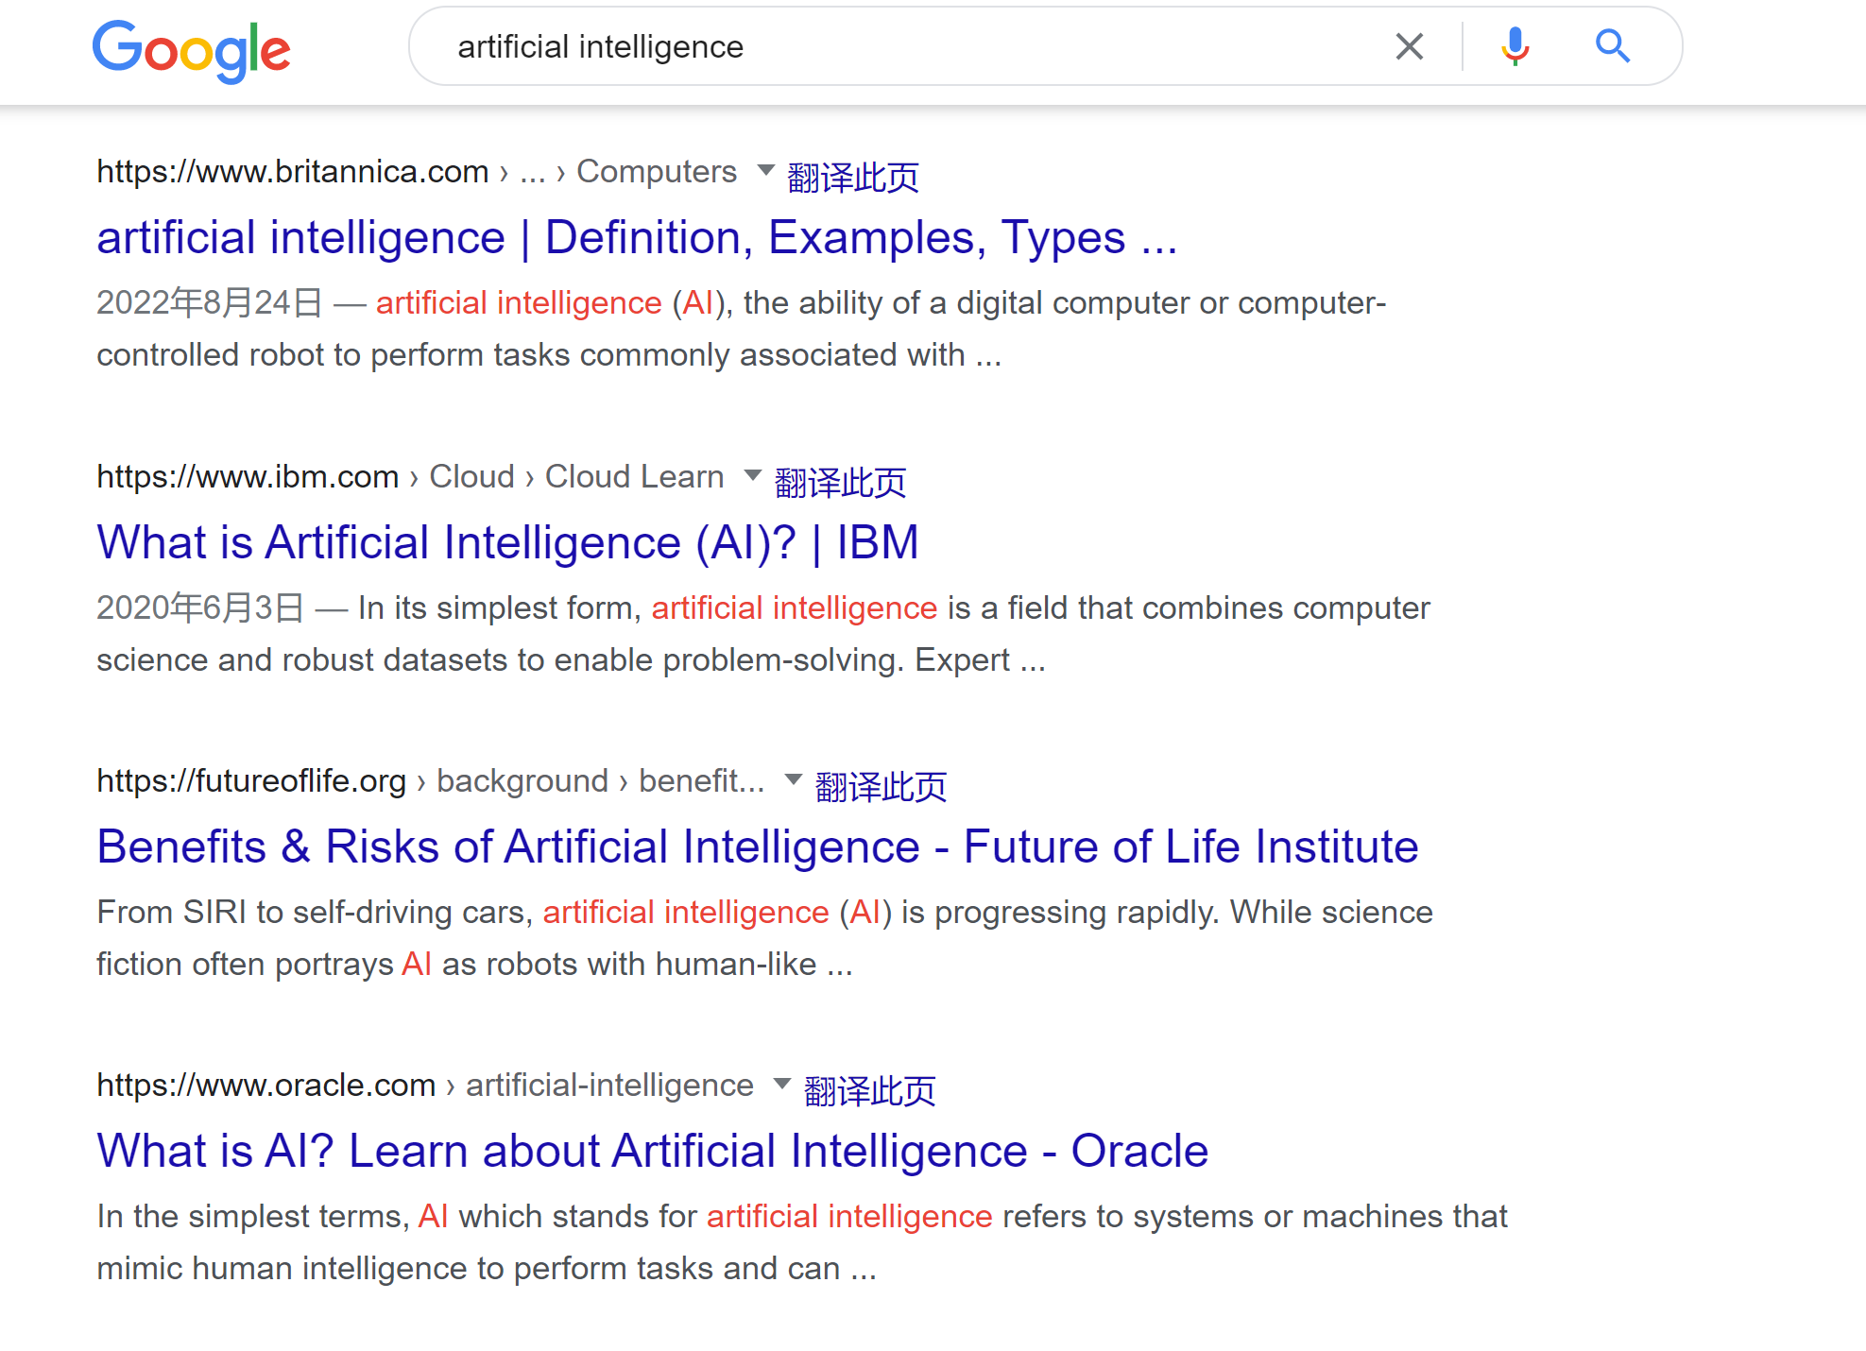
Examples of Information Retrieval

Slide 44
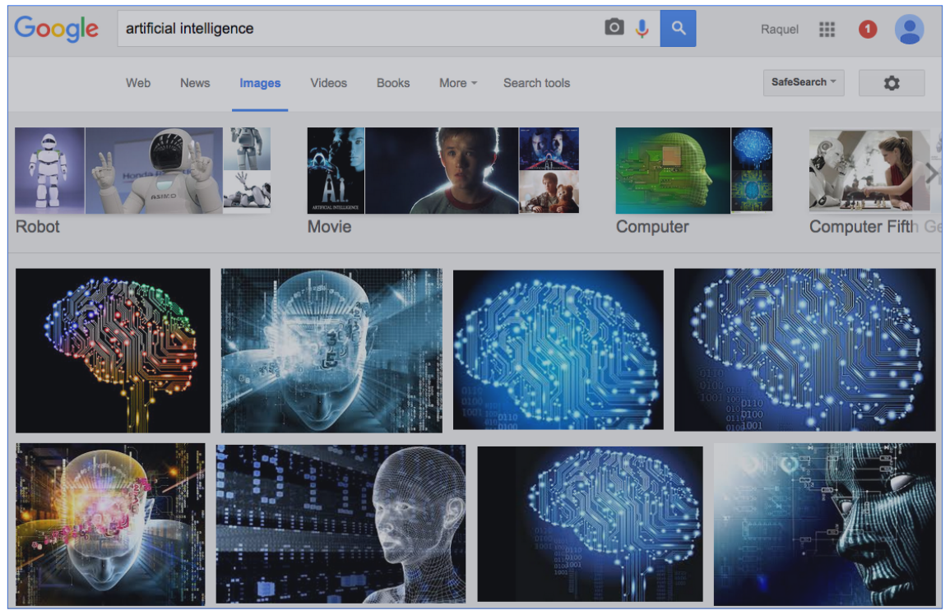
Examples of Information Retrieval

Slide 45
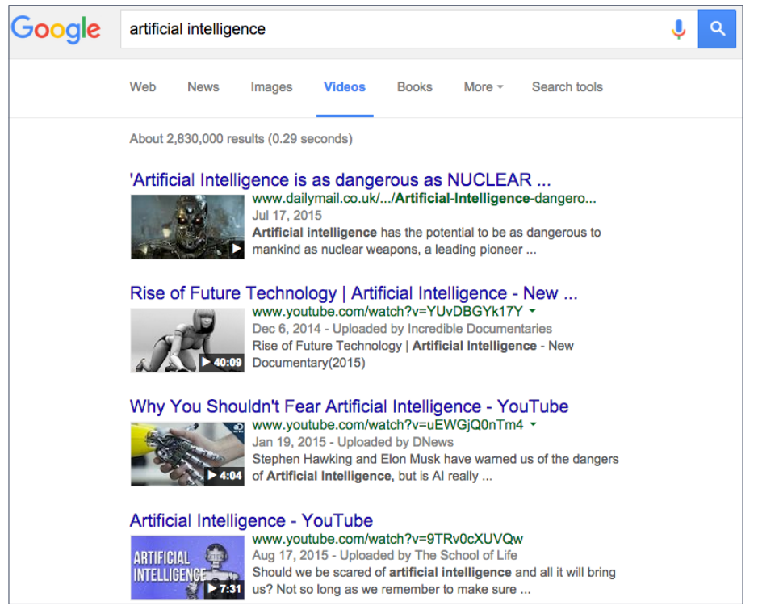
Examples of Information Retrieval

Slide 46
Learning algorithms are useful in other tasks
1. Classification: Determine which discrete category the example is
2. Recognizing patterns: Speech Recognition, facial identity, etc
3. Recommender systems: Noisy data, commercial pay-off (e.g., TikTok, Taobao).
4. Information retrieval: Find documents or images with similar content
5. Computer vision: detection, segmentation, depth estimation, optical flow, etc

Slide 47

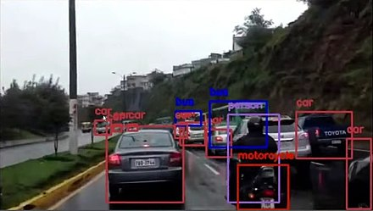
Computer Vision
Object detection: deals with detecting instances of semantic objects of a certain class (such as humans, buildings, or cars) in digital images and videos.
Objects detected with OpenCV's Deep Neural Network module (dnn) by using a YOLOv3 model capable to detect objects of 80 common classes.
Detection of objects on a road

Slide 48
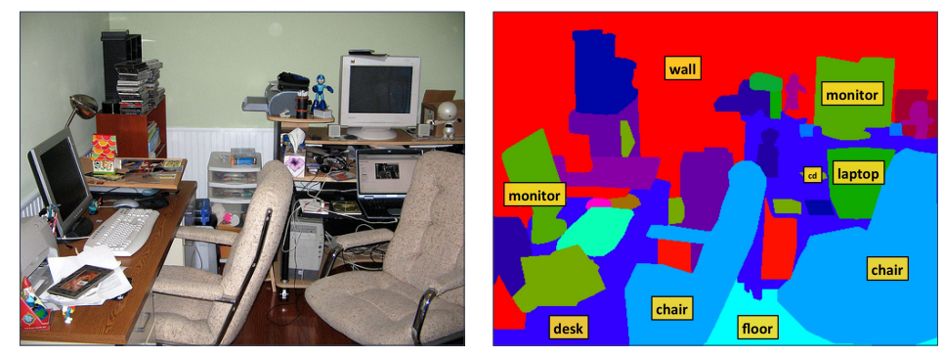
Computer Vision
Image segmentation: partition a digital image into multiple image segments (sets of pixels). The goal of segmentation is to simplify and/or change the representation of an image into something that is more meaningful and easier to analyze.

Slide 49
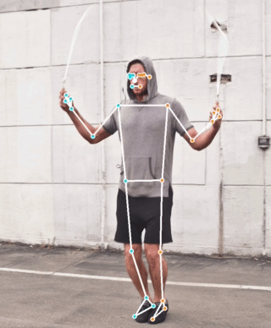
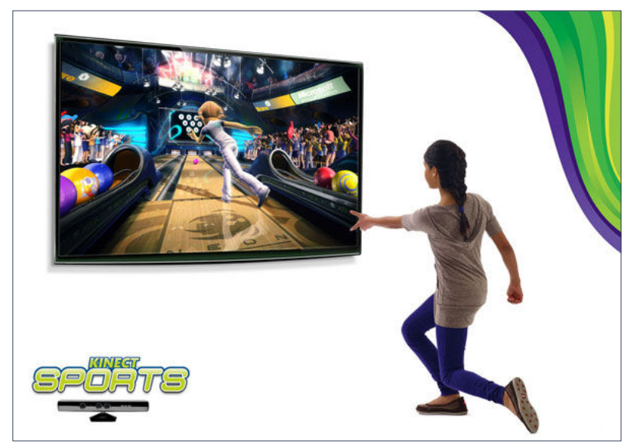
Computer Vision
By using RGB-D camera, estimate a human pose

Slide 50
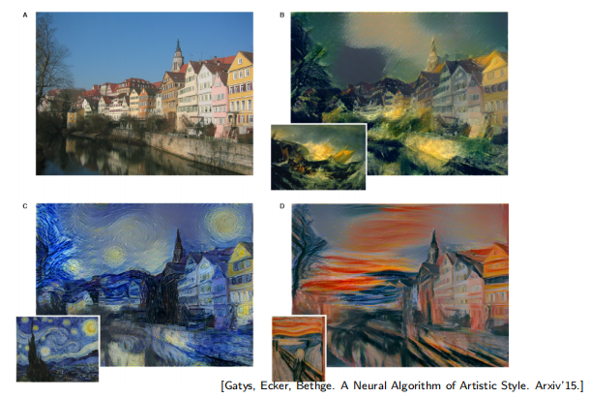
Computer Vision
Convert a picture with artistic styles

Slide 51
Learning algorithms are useful in other tasks
1. Classification: Determine which discrete category the example is
2. Recognizing patterns: Speech Recognition, facial identity, etc
3. Recommender systems: Noisy data, commercial pay-off (e.g., TikTok, Taobao).
4. Information retrieval: Find documents or images with similar content
5. Computer vision: detection, segmentation, depth estimation, optical flow, etc
6. Robotics: perception, planning, etc

Slide 52
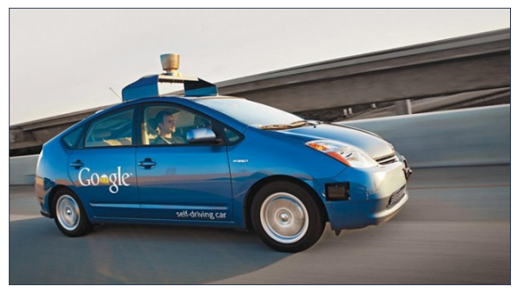
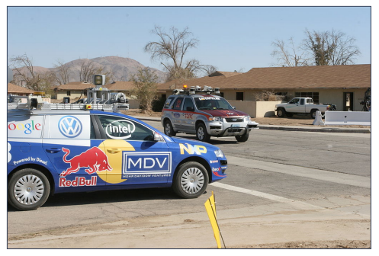
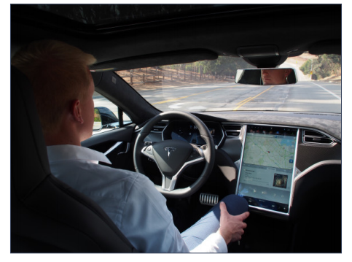
Autonomous Driving
A self-driving car (also known as an autonomous car or driverless car).
In many aspects, it uses artificial intelligence techniques to make cars self-driving.

Slide 53
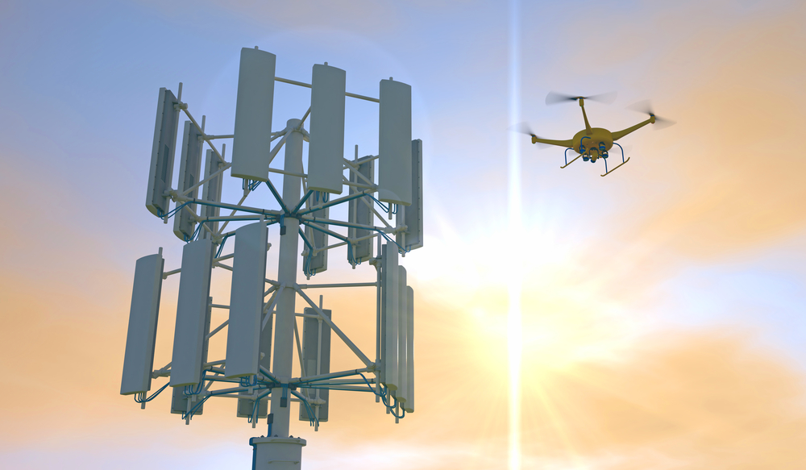
Flying Robots
A deep learning neural network helps drones sift through crowds to find and identify persons of interest. It can even inspect large industrial equipment, like telephone towers, and generate a real-time damage report.

Slide 54
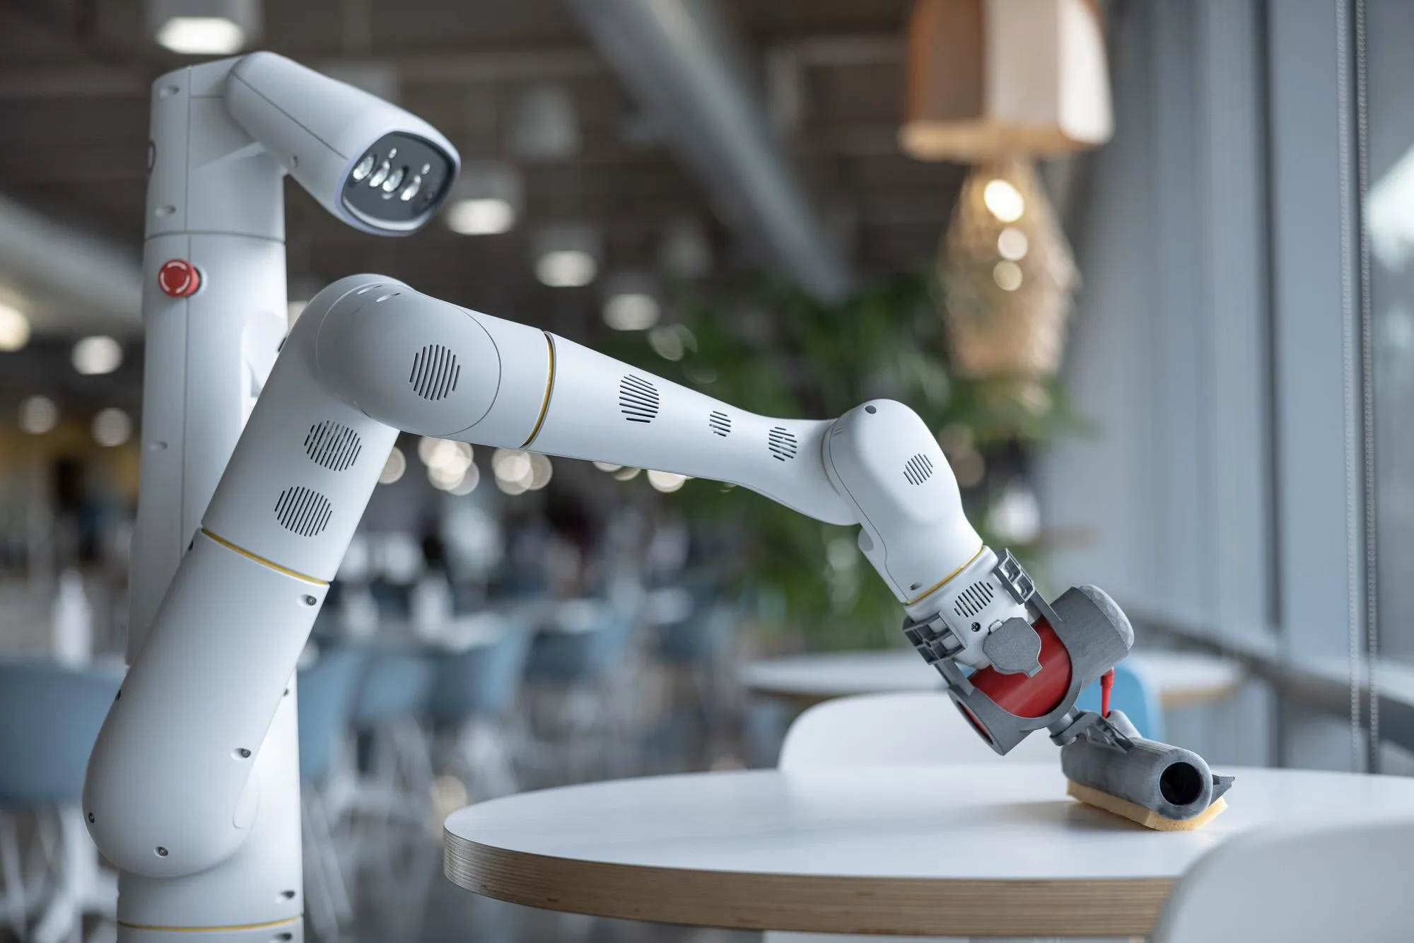
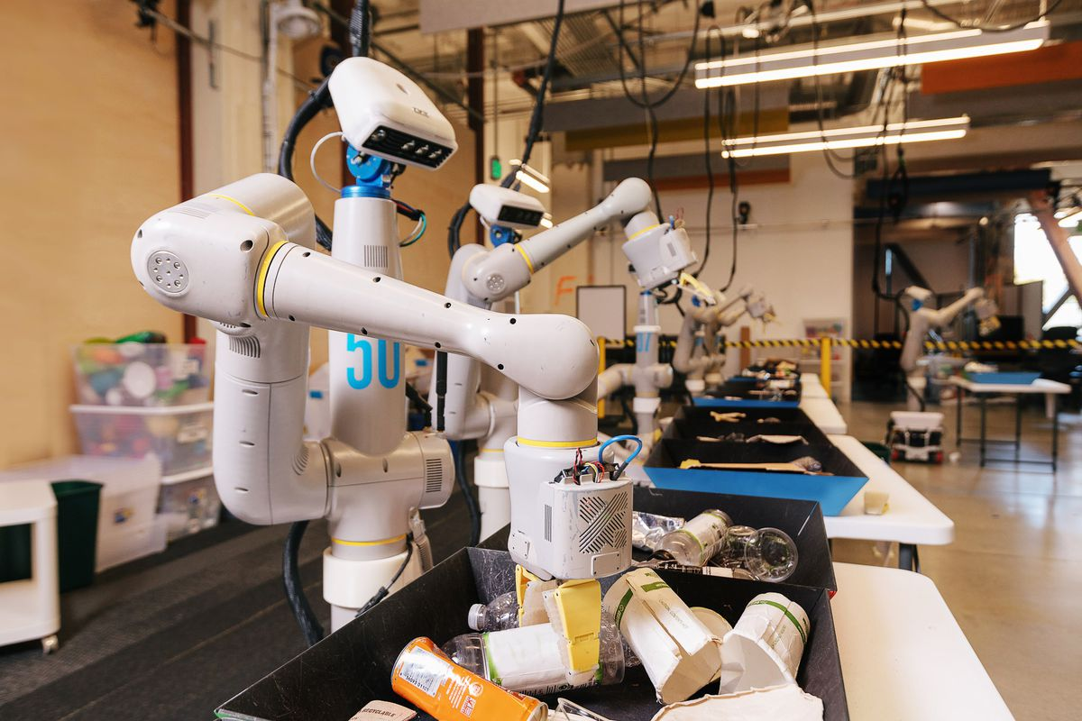
Everyday Robots
Today, robots are expensive and perform highly specialized tasks. But what if a robot could be affordable and taught by just about anyone?
The everyday robot project creates a robot that can be taught by anyone requires tackling some of the hardest challenges in the field of robotics.They could help people with whatever they needed, doing tasks we haven't even dreamed up yet.

Slide 55
Learning algorithms are useful in other tasks
1. Classification: Determine which discrete category the example is
2. Recognizing patterns: Speech Recognition, facial identity, etc
3. Recommender Systems: Noisy data, commercial pay-off (e.g., Amazon, Netflix).
4. Information retrieval: Find documents or images with similar content
5. Computer vision: detection, segmentation, depth estimation, optical flow, etc
6. Robotics: perception, planning, etc
7. Learning to play games

Slide 56
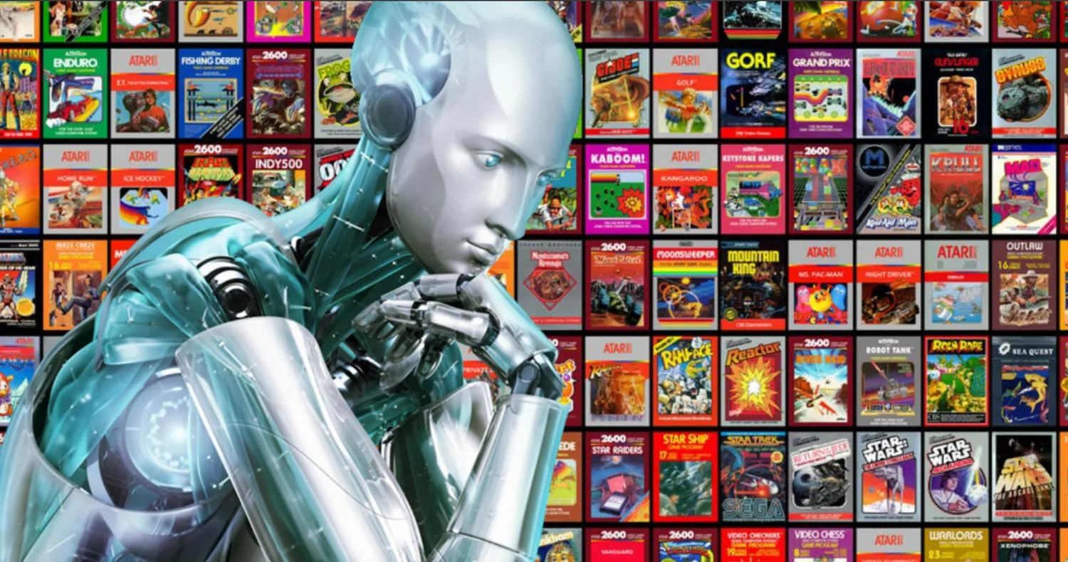
Playing Games: Atari
Researchers at Google's DeepMind have produced a reinforcement learning (RL) system called Agent57 that has scored above the human benchmark on all 57 Atari 2600 games
Agent57 uses machine learning called deep reinforcement, which allows it to learn from mistakes and keep improving over time.

Slide 57
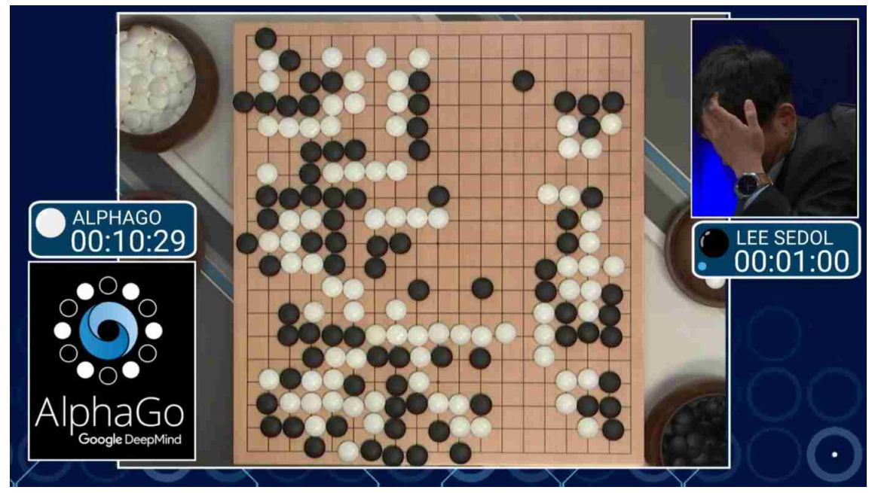
Playing Games: AlphaGo
AlphaGo is the first AI program to defeat a professional human Go player, the first to defeat a Go world champion, and is arguably the strongest Go player in history.

Slide 58
Learning algorithms are useful in other tasks
1. Classification: Determine which discrete category the example is
2. Recognizing patterns: Speech Recognition, facial identity, etc
3. Recommender Systems: Noisy data, commercial pay-off (e.g., Amazon, Netflix).
4. Information retrieval: Find documents or images with similar content
5. Computer vision: detection, segmentation, depth estimation, optical flow, etc
6. Robotics: perception, planning, etc
7. Learning to play games
8. Recognizing anomalies: Unusual sequences of credit card transactions, panic situation at an airport

Slide 59
Learning algorithms are useful in other tasks
1. Classification: Determine which discrete category the example is
2. Recognizing patterns: Speech Recognition, facial identity, etc
3. Recommender Systems: Noisy data, commercial pay-off (e.g., Amazon, Netflix).
4. Information retrieval: Find documents or images with similar content
5. Computer vision: detection, segmentation, depth estimation, optical flow, etc
6. Robotics: perception, planning, etc
7. Learning to play games
8. Recognizing anomalies: Unusual sequences of credit card transactions, panic situation at an airport
9. Spam filtering, fraud detection: The enemy adapts so we must adapt too

Slide 60
Learning algorithms are useful in other tasks
1. Classification: Determine which discrete category the example is
2. Recognizing patterns: Speech Recognition, facial identity, etc
3. Recommender Systems: Noisy data, commercial pay-off (e.g., Amazon, Netflix).
4. Information retrieval: Find documents or images with similar content
5. Computer vision: detection, segmentation, depth estimation, optical flow, etc
6. Robotics: perception, planning, etc
7. Learning to play games
8. Recognizing anomalies: Unusual sequences of credit card transactions, panic situation at an airport
9. Spam filtering, fraud detection: The enemy adapts so we must adapt too
10. Many more!

Slide 61
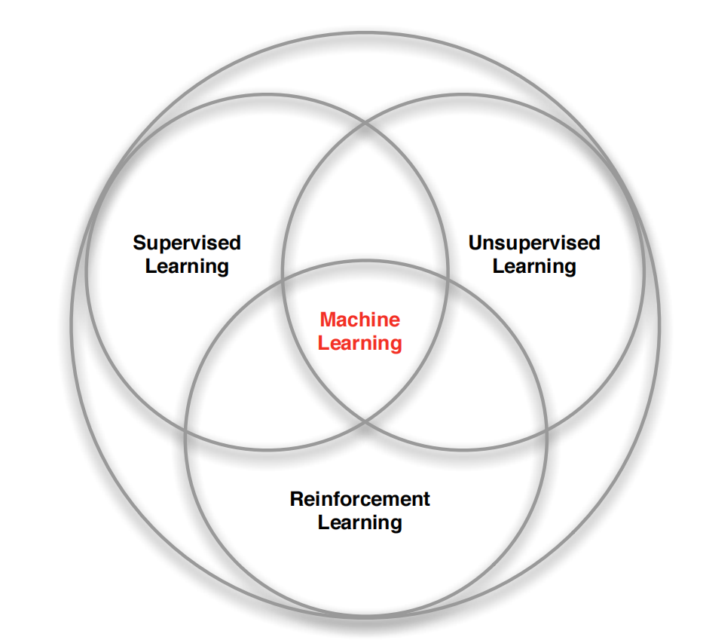
Branches of Machine Learning

Slide 62
Types of learning tasks
Supervised learning:
Require a training set of example inputs and their corresponding desired outputs, which the algorithm uses to learn a model of the mapping from inputs to outputs.
After the model is learned, the algorithm can generate outputs for new inputs.
Classification: 1-of-N output (speech recognition, object recognition, medical diagnosis)
Regression: real-valued output (predicting market prices, customer rating)

Slide 63
Types of learning tasks
Unsupervised learning:
Do not require a training set, but instead, learn a model of the input data by detecting patterns in it.
Unsupervised learning algorithms can be used to discover structure in data or to cluster data into groups.
Examples: Form clusters; Extract features

Slide 64
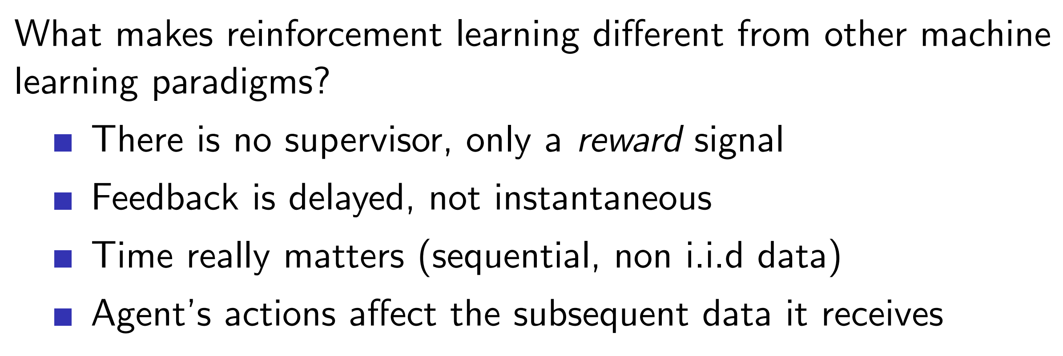
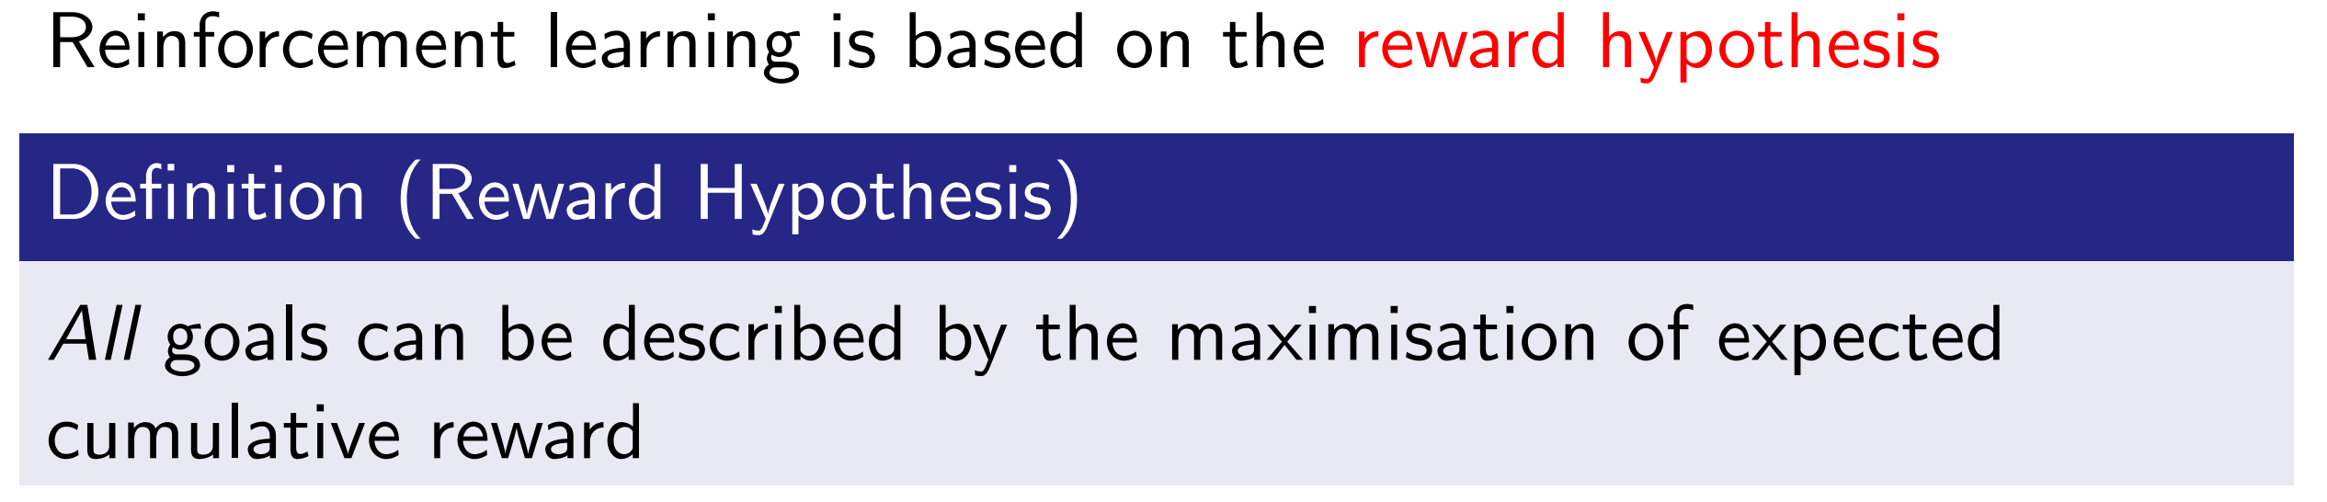
Types of learning tasks
Reinforcement learning:

Slide 65
Install Python
Install Anaconda
Anaconda is a distribution of the Python and R programming languages for scientific computing (data science, machine learning applications, large-scale data processing, predictive analytics, etc.), that aims to simplify package management and deployment.
Download the right version from https://www.anaconda.com/
After installing Anaconda, you will notice the following in the start-up menu (under “Anaconda3” folder)
Anaconda Powershell Prompt
Jupyter Notebook (Jupyter is a very popular application used for data analysis. It's an IPython notebook ("interactive python"). You can run each block of code separately.)
Spyder (Spyder is an Integrated Development Environment (IDE) for Python like Atom, Visual Studio, etc. )

Slide 66
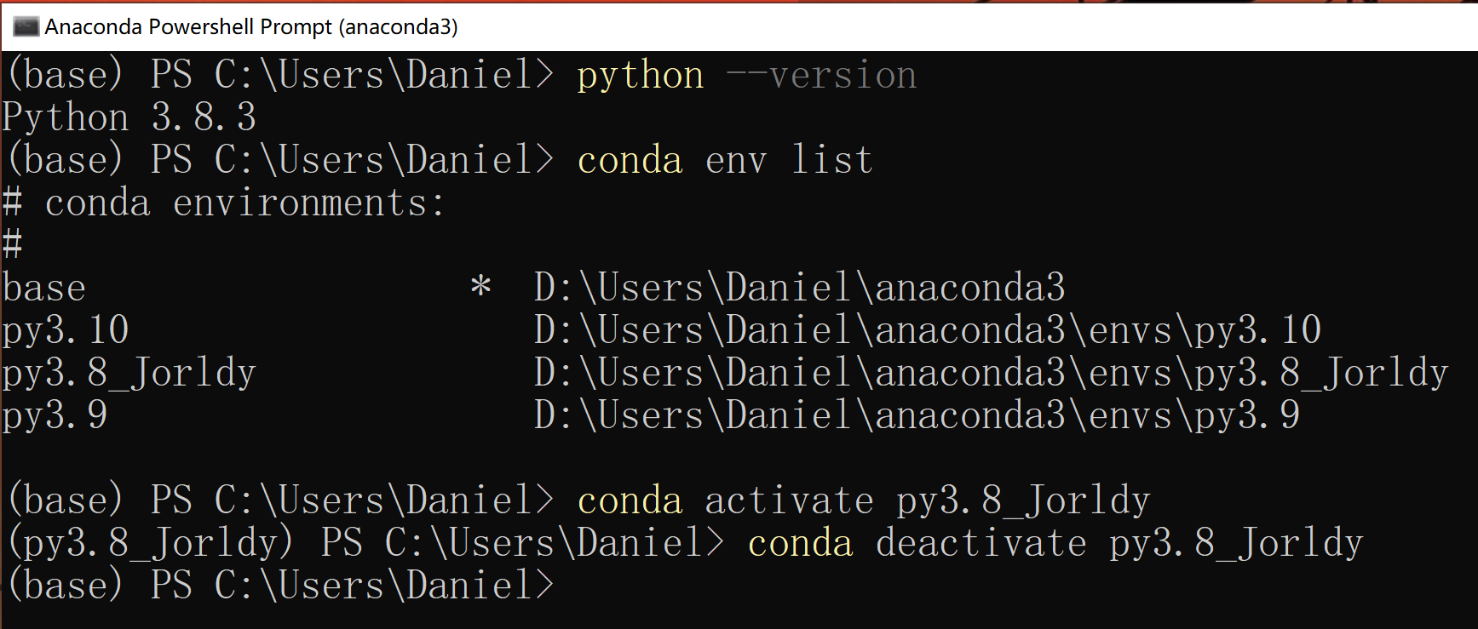

Install Python (cont’d)
Open “Anaconda Powershell Prompt”
Manage Python environment with conda

Slide 67

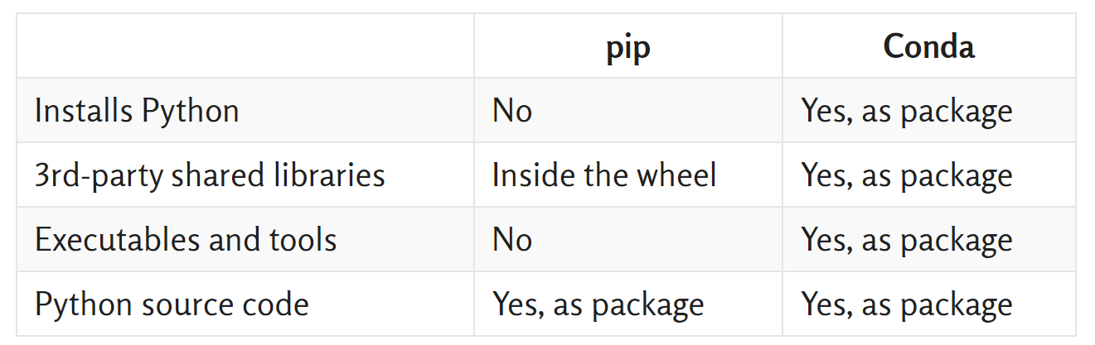
Install Python (cont’d)
Python Packages:
Suppose you have developed a very large application that includes many modules. Packages allow for a hierarchical structuring of the module namespace using dot notation.
Creating a package is quite straightforward, since it makes use of the operating system’s inherent hierarchical file structure.
Install Python Packages (e.g., NumPy: the core library for scientific computing in Python)
conda install xxx
pip install xxx

Slide 68
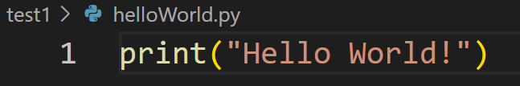
Edit and Run Python Code
Spyder (an IDE for Python)
Python file: xx.py
VS Code (suggest! Visual Studio Code is a code editor redefined and optimized for building and debugging modern web and cloud applications. )
https://code.visualstudio.com/
How to run Python code
pyhton xxx.py
Jupyter Notebook (Interactive python)
IPython file: xx.ipynb
Convert xx.ipynb to xx.py: Download as Python (.py)
run xx.py into an IPython notebook cell: %run xx.py

Slide 69
Homework Assignment
To have the Python environment and packages ready on your computer
Install Anaconda (Windows/Linux OS)
Create a virtual environment and install Python (suggest Python version 3.7, 3.8, or 3.9)
Install required packages: numpy, scipy, scikit-learn, matplotlib
Take a screen shot for the following
conda env list
activate your environment and python --version
show that all above packages are installed by using the command pip show xxx (xxx refers to the package name above)
Install VS code and get familiar with the use of VS code as well as Jupyter Notebook
Take a screen shot for the following
Edit a simple sample xx.py file using VS code
Run the python script in VS code terminal and show the output
Edit a simple sample xx.ipynb file using Jupyter Notebook
Run the cell in the iPython file and show the output

